Slide 1




Campus Management System

Slide 2
Presentation Outline
Lesson 1 : Objectives
Lesson 2 : Company Overview
Lesson 3 : Project Role
Lesson 4 : Project Business Value
Lesson 5 : Lessons Learnt

Slide 3
Overview of Company & Project
ST Electronics Training & Simulation Systems
Training & Consultancy Services, Edutainment solution, and simulation system provider
Learning Technologies Service
Campus Management System
School Information & Administration System
Training Management System
Learning Management System

Slide 4
Business Value
Benefits derived by company
Flexibility and adaptability using microservices and cloud technologies
Customize to meet client requirements quickly with open source LMS

Slide 5
Project Role
Write and edit code on new and existing modules and software to meet client requirements
Research and experiment on new technology stacks and architecture to improve on code reusability and ability to meet client requirements

Slide 6
Deliverables & Benefits to Company
Deliverables & Benefits to Company
Built simple console app connecting PostgreSQL database to C# application on .Net Core and EF Core
Database first and Code first approaches
Use GUI pgAdmin to create new and restore existing databases and run querues
Explore PostgresQL with .Net Core
PAGE 6
Notes:
Add in the 2 pictures for the RabbitMQ

Slide 7
Deliverables & Benefits to Company
Deliverables & Benefits to Company
Configure and create customized user permissions
Exploration and application of autoscaling options in AWS including Elastic Beanstalk
Configure AWS cloud technology
PAGE 7
Notes:
Add in the 2 pictures for the RabbitMQ

Slide 8
Deliverables & Benefits to Company
Deliverables & Benefits to Company
A simple student Registration module were build.
Main achievement is the implementation of RabbitMQ message broker for communication.
Establish basis for inter-services communications for future microservices project
Customization on features of open source LMS
PAGE 8
Notes:
Add in the 2 pictures for the RabbitMQ

Slide 9
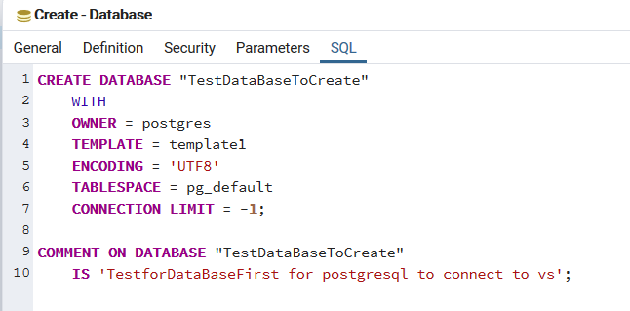
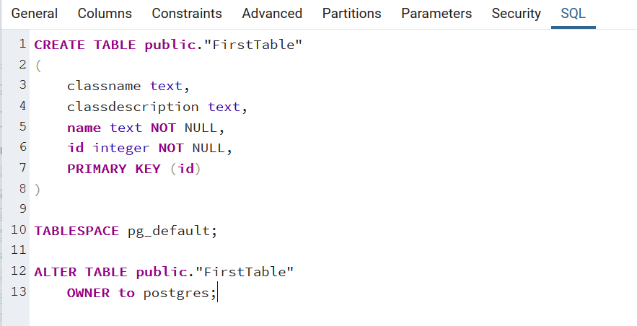
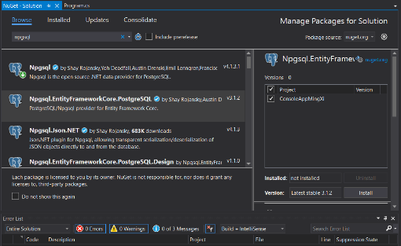
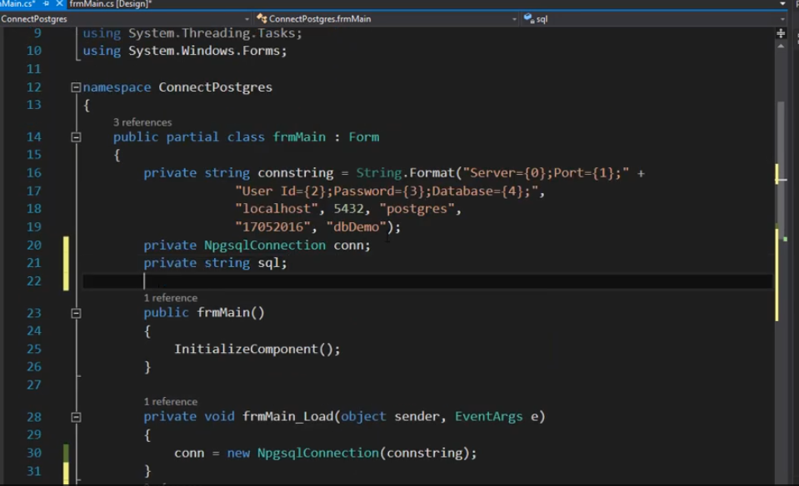
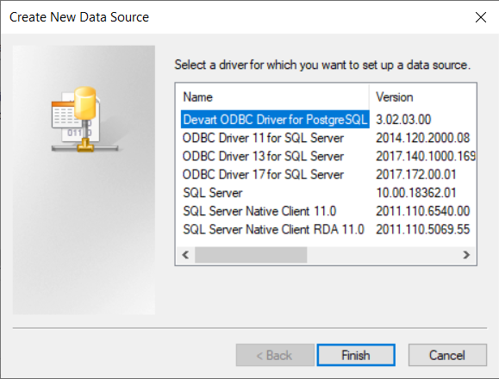
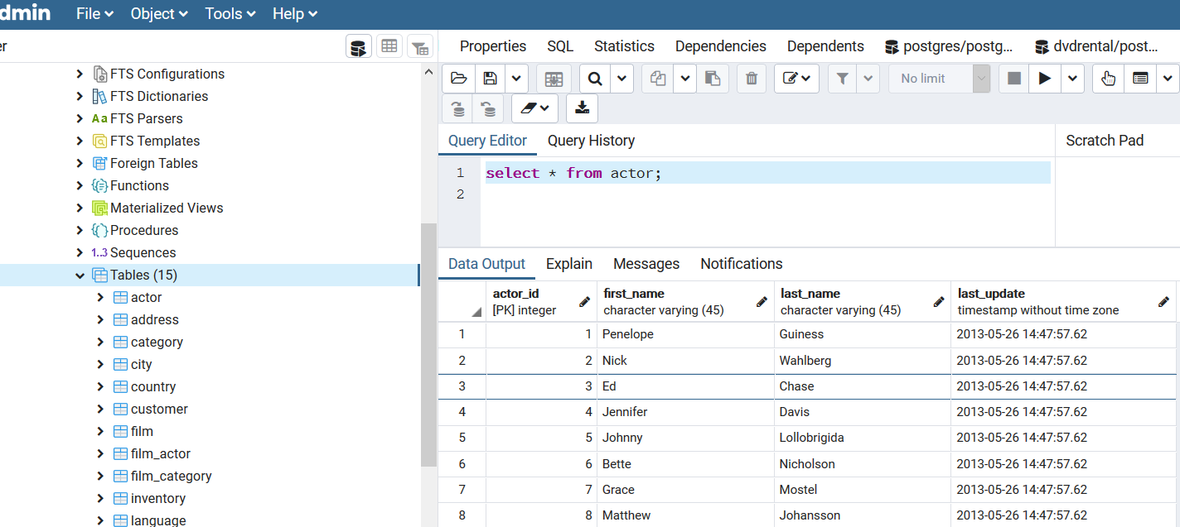
Demonstration of applications and technologies
Break down into steps
First Skill
Second Skill
Third Skill
Conclusion

Slide 10
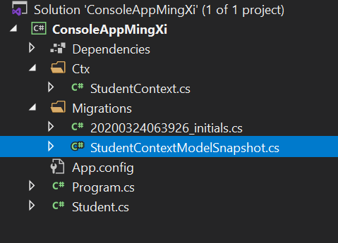
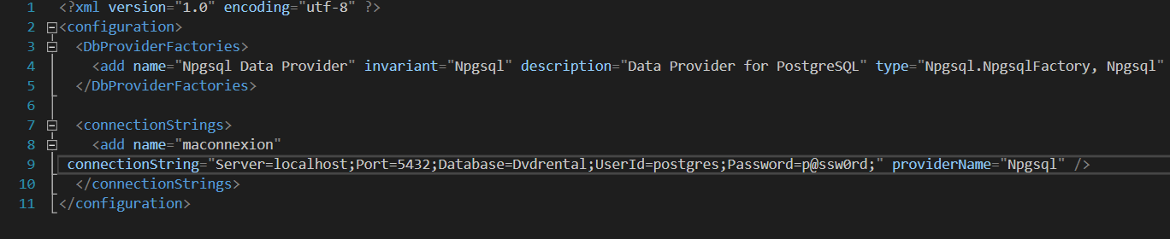
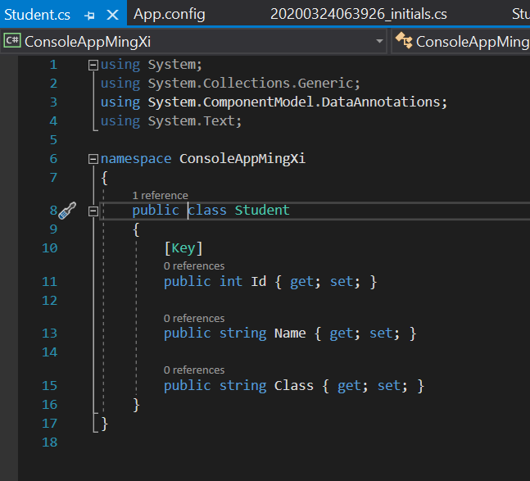
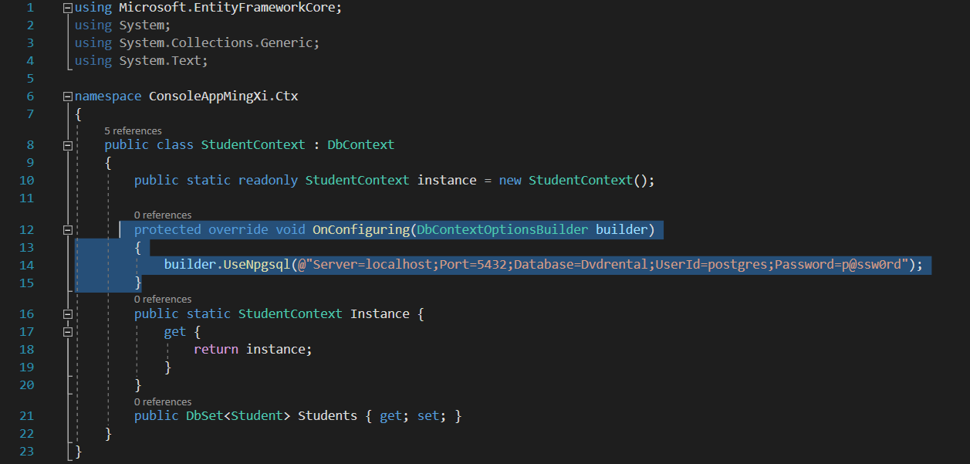
Demonstration of applications and technologies
Break down into steps
First Skill
Second Skill
Third Skill
Conclusion

Slide 11
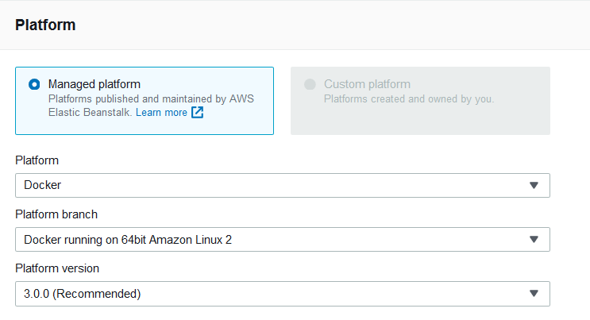
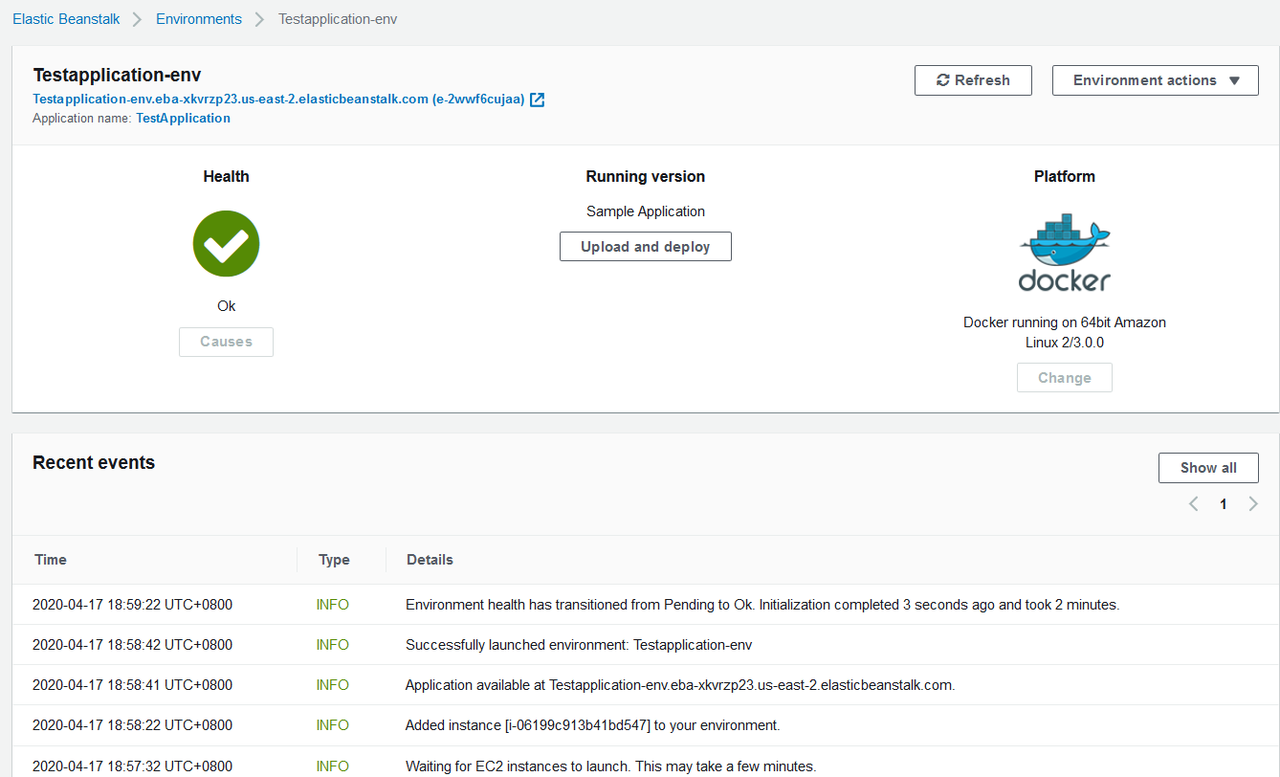
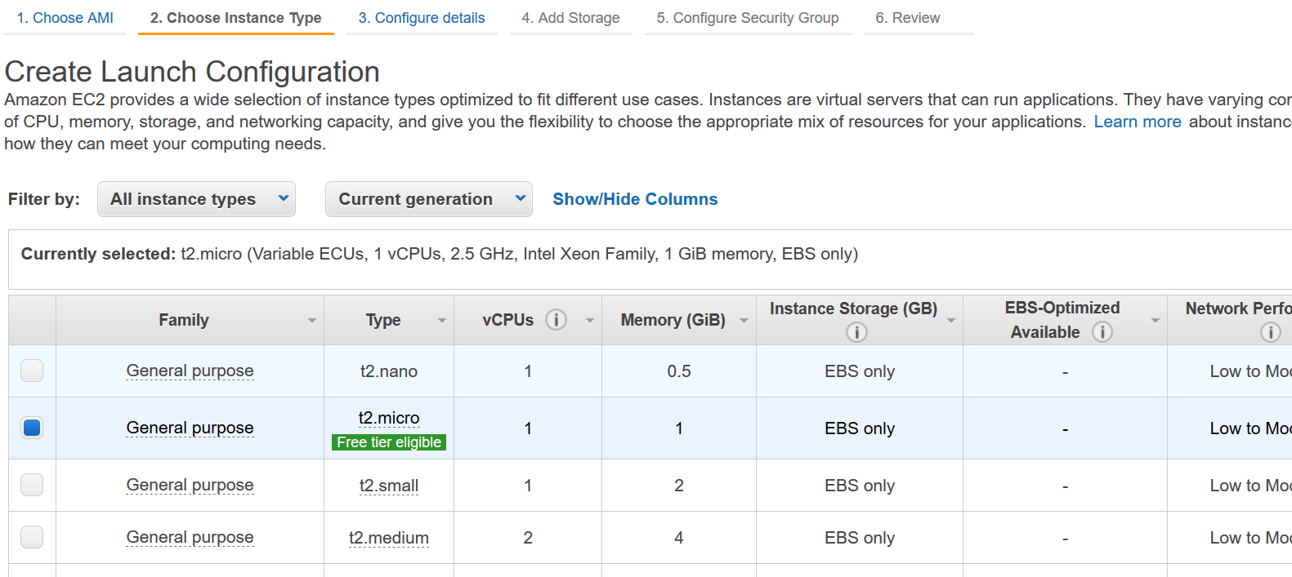
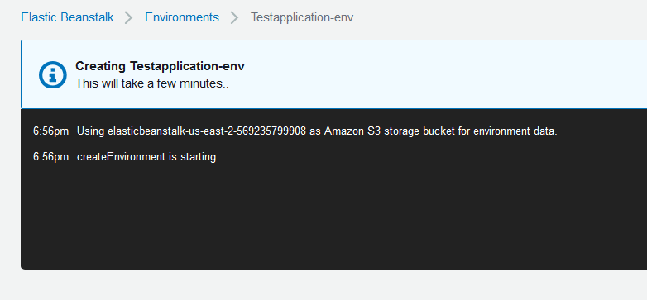
Demonstration of applications and technologies
First Skill
Second Skill
Third Skill
Conclusion

Slide 12
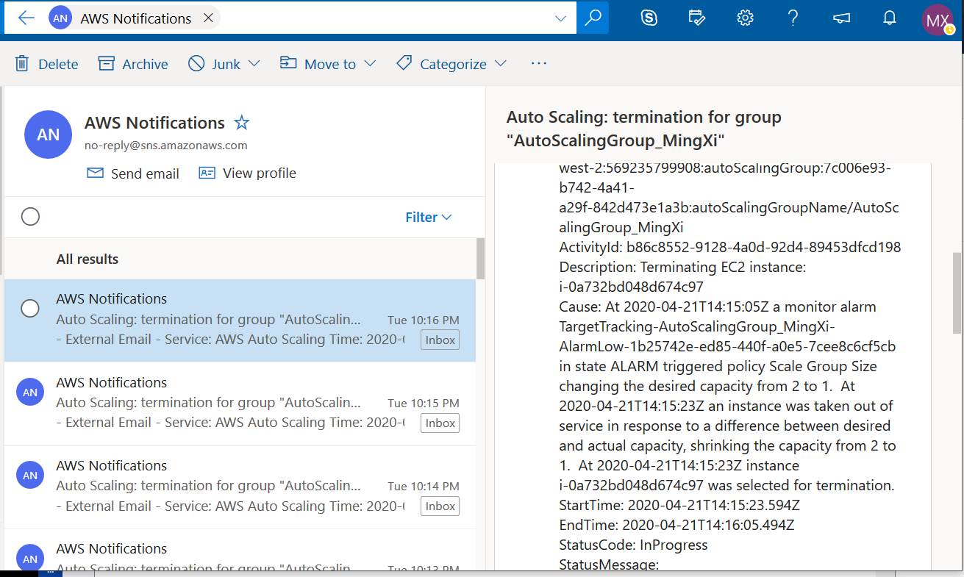
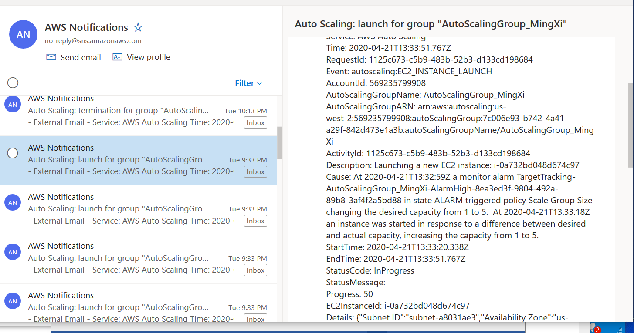
Demonstration of applications and technologies
First Skill
Second Skill
Third Skill
Conclusion

Slide 13
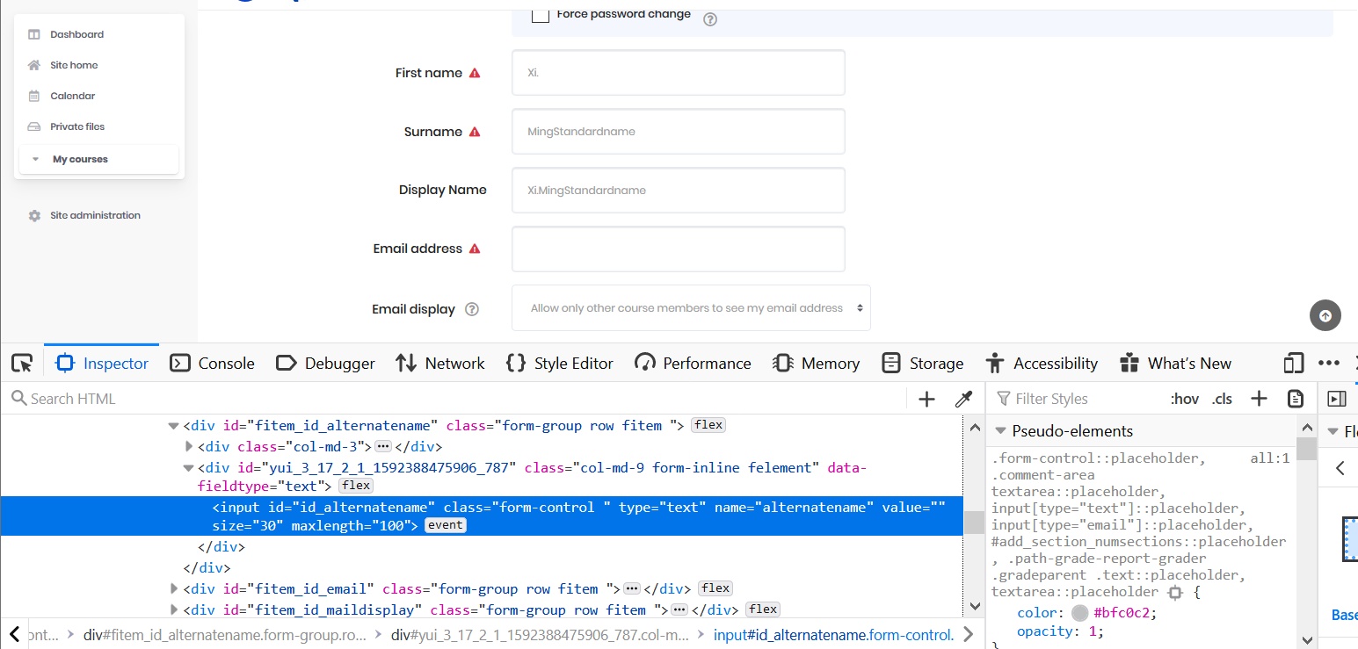
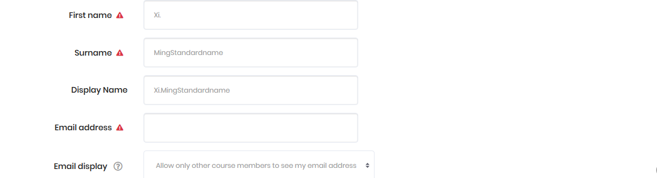
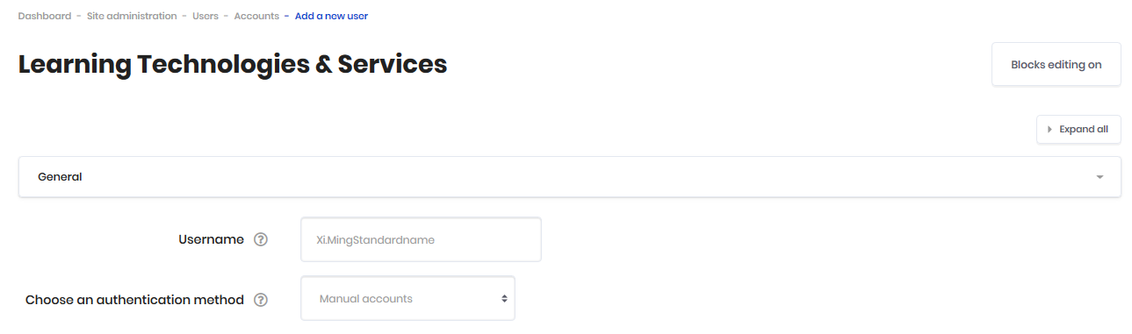
Demonstration of applications and technologies
First Skill
Second Skill
Third Skill
Conclusion

Slide 14
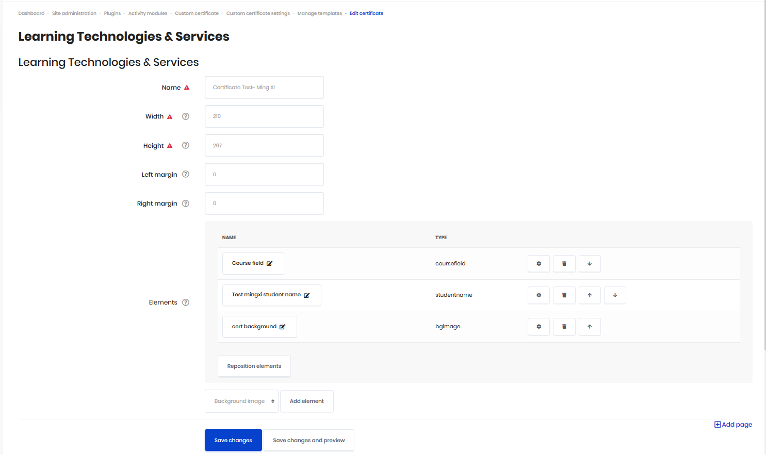
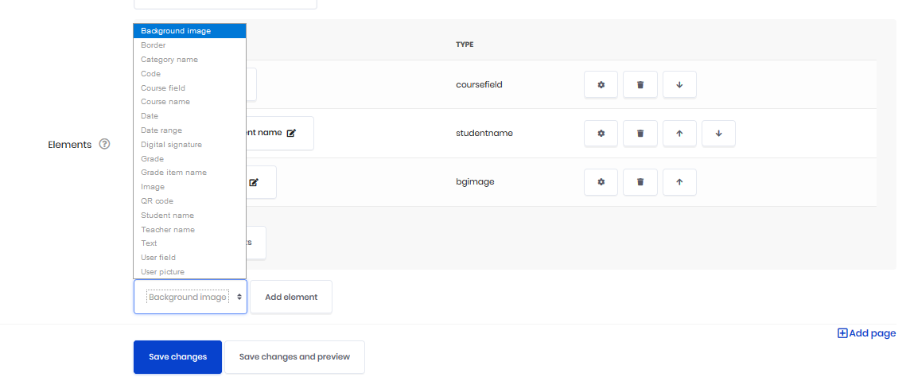
Demonstration of applications and technologies
First Skill
Second Skill
Third Skill
Conclusion

Slide 15
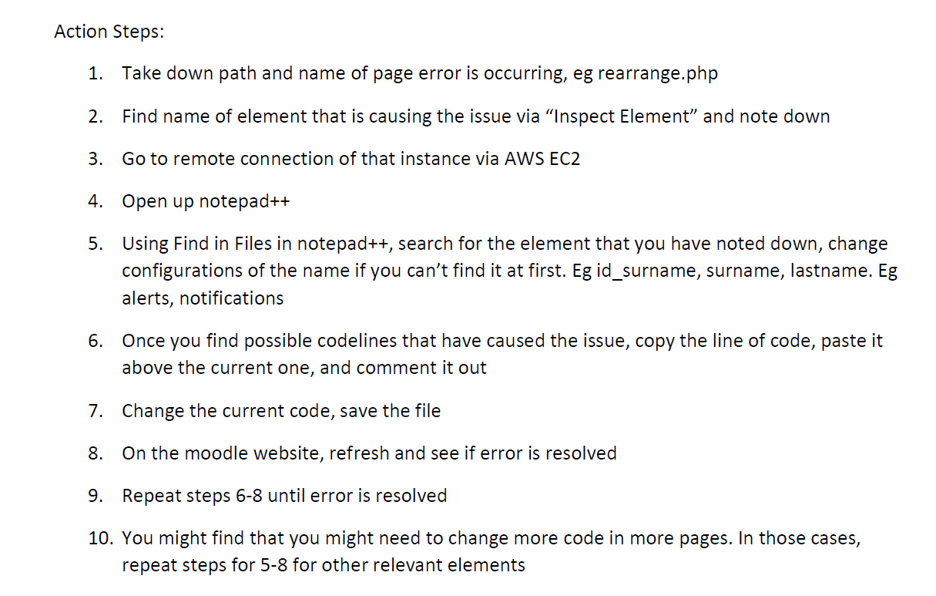
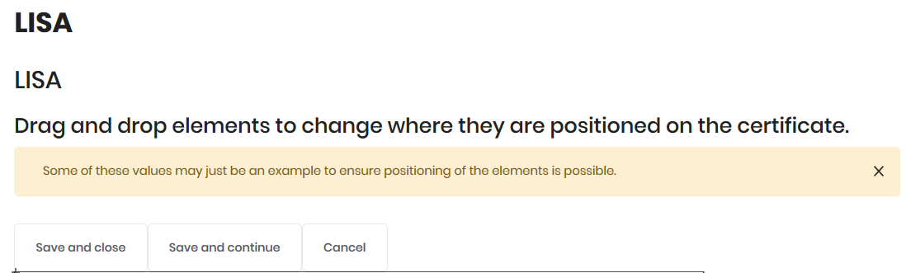
Demonstration of applications and technologies
First Skill
Second Skill
Third Skill
Conclusion

Slide 16
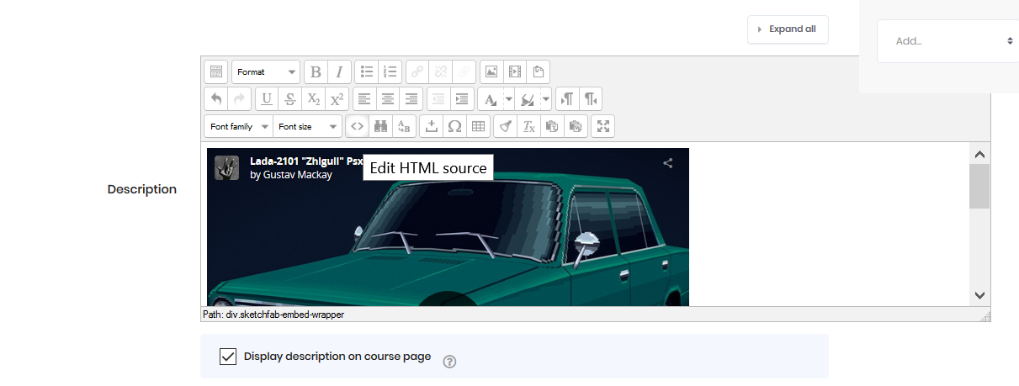
Demonstration of applications and technologies
First Skill
Second Skill
Third Skill
Conclusion

Slide 17
Demonstration of applications and technologies
First Skill
Second Skill
Third Skill
Conclusion

Slide 18
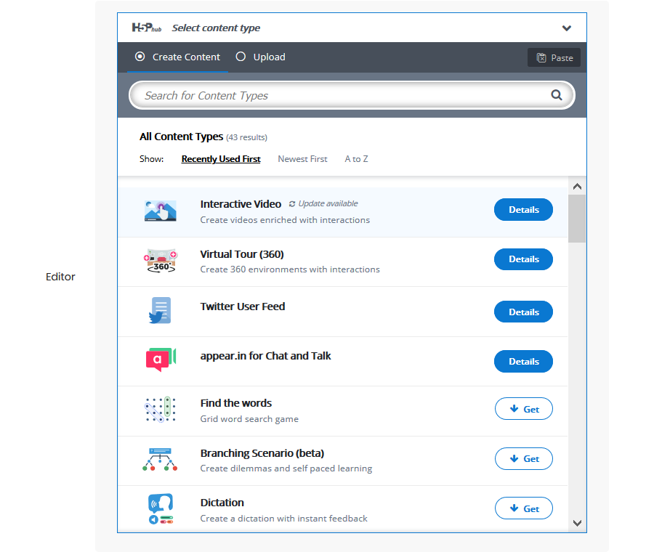
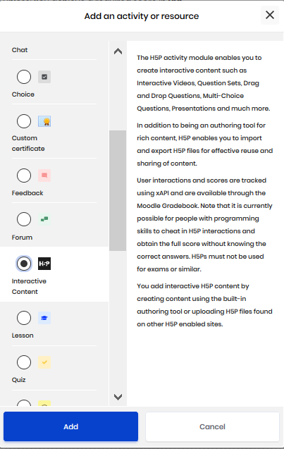
Demonstration of applications and technologies
First Skill
Second Skill
Third Skill
Conclusion

Slide 19



Skills Learnt - for any new technology, framework or tools:
Problem solving - break down into smaller steps
Roundabout ways to solve problems even if not familiar with software
or the programming language
Experimental steps to explore new technology and report on suitability for objectives to be met
Second Skill
First Skill
Third Skill
Conclusion

Slide 20
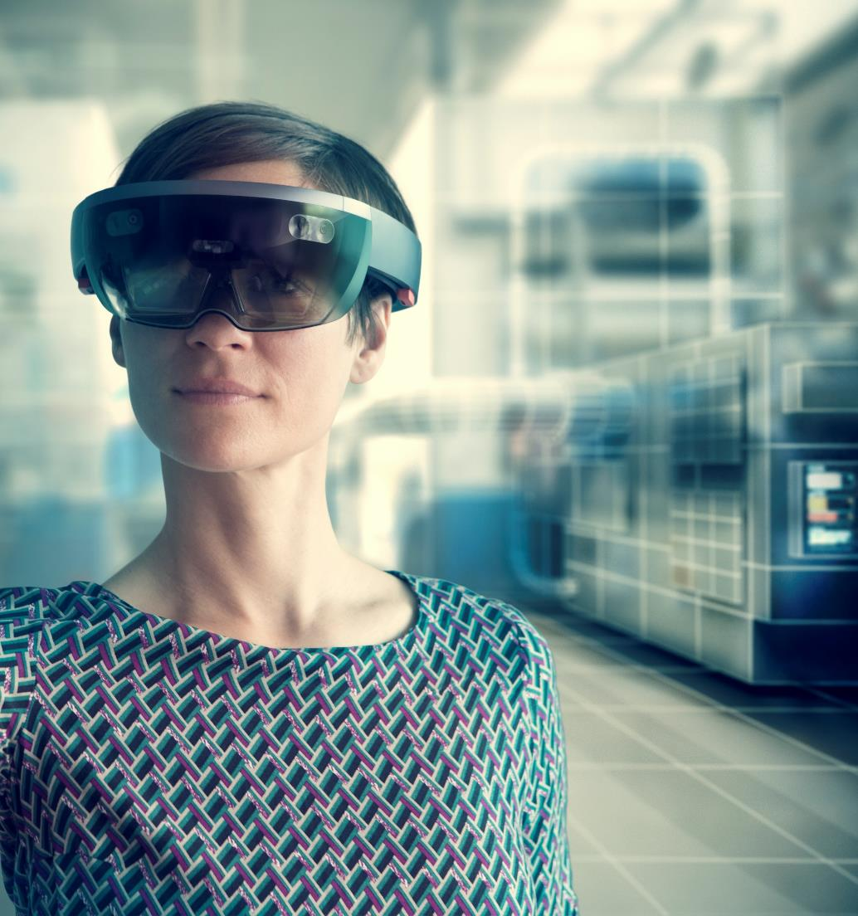
Lessons Learnt
immediate feedback loop and reducing frustration
find ways to create closer feedback loop for processes to improve work engagement
reduce friction in terms of accessibility of learning ==> find ways to reduce gap with existing knowledge and new knowledge
increase friction in terms of having processes that increase opportunities to think and reflect
clarify boundaries and expectations clearly
Third Skill
First Skill
Second Skill
Conclusion

Slide 21
Conclusion
Here is what I learned
Learnt how to learn new technology which was not exposed to in coursework because there were ready materials from school
Confidence and experience to explore and learn new frameworks and technology by
Put people into roles suited for them, clarify expectations, end objectives and connect to values
Conclusion
First Skill
Second Skill
Third Skill

Slide 22
Thank You
Creators:
[ Ge Xiao Min ] [ Liou Cheng Xiang ]
[ Ming Xi ] [ Yeo Shen Yean ] GDipSA Batch 49

